Slide 1
Fintech and Artificial Intelligence in Finance –
Towards a transparent financial industry
COST Action 19130
COST FInAI Core Group Meeting
24 April 2024

Slide 2

Agenda
COST Action 19130: FinAI
  Overview
  State of work
  Long term impact
Vision XAI

Slide 3
The journey from September 2020 until May 2024: three highlights
The network
The activities
The research
From 20 countries to 51 countries
From 98 members to 413 members
From 0 to more than 2600 members on Meetup
>370 conferences, events, workshops
> 40 meeting and TS held and scheduled until end of 2024
Many sub-teams working together
Several H2020 and MSCA applications
Many research papers
Many promotions to assistant/associate/full professorship

Slide 4
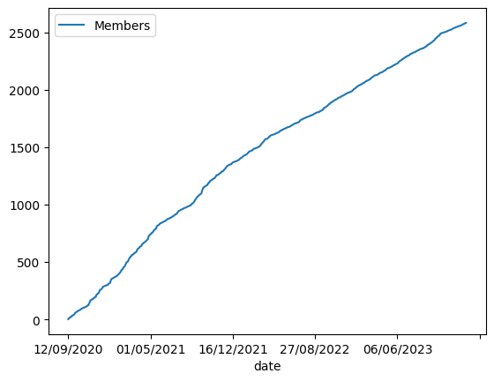

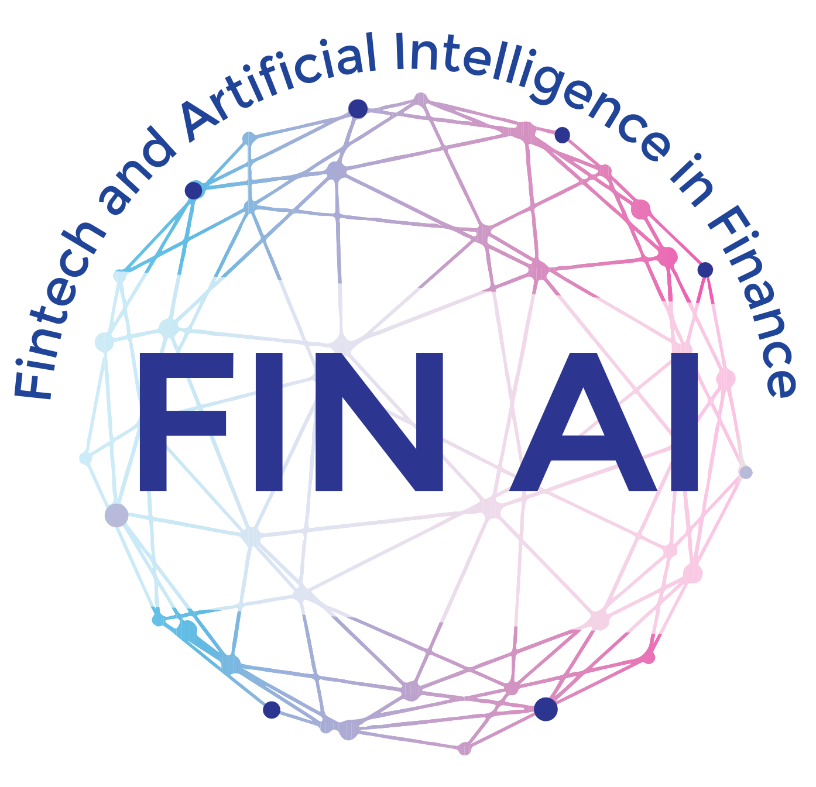
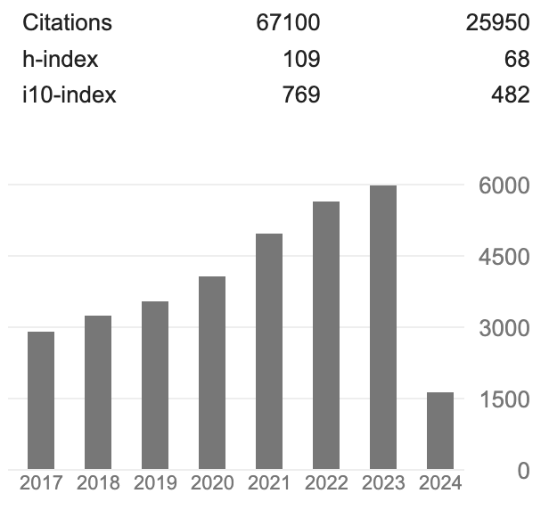
Networking Activities
>370 conferences, workshops and research seminars since June 2020
>2600 members
>6400 participants
51 European countries
>400 researchers
Speakers and participants from all over the world, including Switzerland, USA and Hong Kong
Action starts
BIS, ECB, BoE, FED, IMF

Slide 5





The Research
INTERDISCIPLINARY COOPERATIONS with diverse stakeholders
RESEARCH OUTPUT with an Impact
DISSEMINATION across Europe
> 6000 citations p.a.
> 100 publications p.a.
> h-index > 100 (top 200 university)
> 15 research workshops p.a.
> 1000 participants p.a.
40 European countries
> 400 researchers from 51 countries globally
Fintech and AI in Finance
Towards a Transparent Financial Industry
> 40 research funding applications

Slide 6
Deliverables

Slide 7
3.5 years Evaluation
Research Output
Research Impact
Research Community
Highly successful
Impressive progress
Quality of publications is very good
Relevance of publications is excellent
Quantity of publications is excellent
Plays a significant role in promoting state of the art
Highly effective dissemination activities
Highly effective exploitation activities
Significance of publications is excellent
400+ members from 50+ countries
Significant number of initiatives
Development of a vibrant and diverse scientific community
Overall, the COST FinTech and AI in Finance Action has so far made impressive headways in mobilising a robust FinTech community and progressing the State of the Art in FinTech-related data science and successfully disseminating a large body of associated and highly consequential research.

Slide 8
Vision XAI
Summary
Innovation
Expected Impact

Slide 9
Vision XAI
Work and Exploitation Plan

Slide 10
Vision XAI
Why COST Innovators Grant?

Slide 11
Fintech and Artificial Intelligence in Finance –
Towards a transparent financial industry
COST FInAI Core group meeting
Thank you!

